Slide 1
Lakeland Electric
Spring 2025
Notes:
Sam

Slide 2
Problem Statement
Lakeland Electric needs to plan for the impact of future construction. They need to forecast their future demand. Existing forecast models may not specifically reflect Lakeland specific conditions.
This project will develop a forecasting model for Lakeland starting with residential customers based on Lakeland specific conditions.
Notes:
Sam

Slide 3
Customer Needs
Staff at Lakeland Electric need accurate load predictions to ensure they can reliably meet growing electricity demand without interruptions, while keeping rates fair and manageable for their customers.
We must improve load prediction models to account for future growth, analyze demand to anticipate shortfalls, and determine if electricity purchases or rate adjustments are needed to help Lakeland Electric meet growing demand reliably, and manage rates fairly for their clients.
Notes:
Jackson

Slide 4
Constraints, Situational Context, Relative Codes & Standards
Constraints: The dataset was limited in both scope and scale. It only included historical data from a few residential buildings and didn’t have any real-time data. Because of that, the model couldn’t fully capture how load changes across the entire grid.
Situational Context: Lakeland Electric currently uses commercial tools like Itron for forecasting, which already factor in things like weather and calendar effects. But these models are built for broader system-level forecasts and aren’t really designed for hourly-level predictions or dynamic pricing. This project looks at whether building a custom model using Lakeland-specific weather, pricing, and load data can improve accuracy and better support future planning.
Relative Codes & Standards: Best data practices such as transparency and reproducibility were followed. The modeling also follows good forecasting methods like rolling window evaluation and bias correction to make sure it’s reliable over time.
Notes:
Sam
-for the constraints we were limited in scope and scale. We didn’t have any real time data and only had a few residential buildings. Due to this load can not fully capture how load changes across the entire grid
-Lakeland uses itron for forecasting which uses weather and calendar events. These models are not really designed for hourly level predictions and dynamic pricing. This project looks at wehter a custom model using Lakeland specific conditions improve accuracy.
-best data practices were followed,

Slide 5
Objectives
Develop a forecasting model using Lakeland-specific data to predict residential load and revenue based on real customer usage behavior.
Create a model for a set number of residential customers that can be later scaled to use for the other customer types.
Utilize hourly and daily data, rather than monthly aggregates, to capture patterns and customer priorities.
Notes:
Wenslo

Slide 6
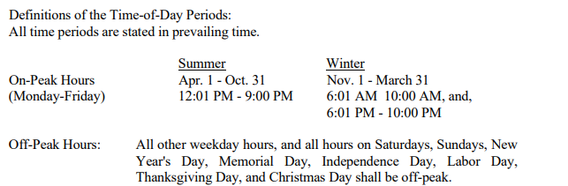
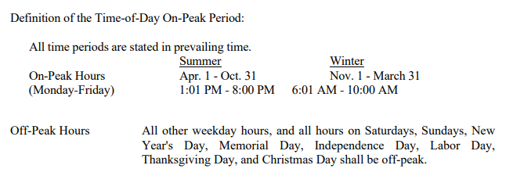
Residential Service Plans
Residential Service - STATIC
  Customer Charge: $14/month
  Energy Charges:
    0–1,000 kWh: $0.05392/kWh
    1,001–1,500 kWh: $0.06161/kWh
    Above 1,500 kWh: $0.06816/kWh
Time-of-Day Service - DYNAMIC
  Customer Charge: $14/month
  Energy Charges:
    On-Peak: $0.13709/kWh
    Off-Peak: $0.01544/kWh
Notes:
Wenslo

Slide 7
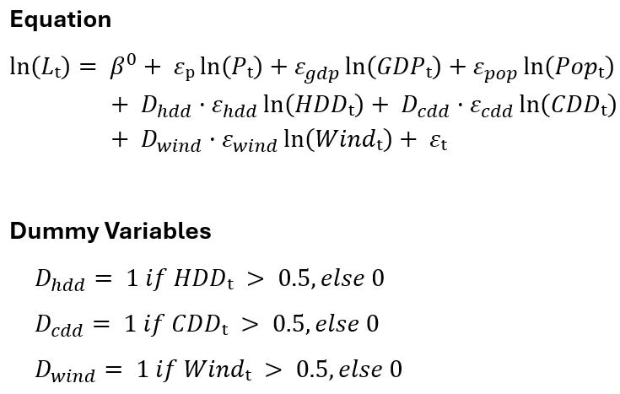

Model Formula
This equation models estimated electricity load based on economic, demographic, and environmental factors. For instance, $P_{t}$ represents electricity price at time t.
Equation uses log transformation for easier interpretation of coefficients as elasticities.
HDD, CDD, and wind speed use a switching equation to handle zeros and only affect the model when their values are high enough.
Notes:
Nick – mention some of the features present, and make sure to mention that HDD/CDD/windspeed need this switching equation because sometimes they have a value of 0 which can't be used in natural log equations

Slide 8
Elasticity Ranges From Research
Elasticities show how electricity demand changes with factors like price, GDP, and weather. Income is represented as GDP and ranges were determined from roughly a hundred research papers.
Example Interpretation: A 1% price increase lowers demand by 0.188% to 0.005%
Higher prices reduce demand, so the price effect is negative.
Higher GDP (income) increases demand, so it's positive.
CDD can be negative or positive, depending on region and behavior.
Wind speed has a small positive effect, meaning it matters slightly but consistently.
Gupta (2014), Emenekwe & Emodi (2022), Atalla & Hunt (2016), Boogen et al. (2013), Fan et al. (2019), Idsø et al (2024)t al. (2024)
Variable | Elasticity Range
Price εₚ | -0.188 to -0.005
GDP εgdp | 0.393 to 1.132
Population εpop | 0.109 to 0.883
HDD εhdd | 0.00 to 0.221
CDD εcdd | -0.66 to 0.335
Wind Speed εwind | 0.011 to 0.022
Notes:
Nick – explain what elasticities are quickly – e.g 1% increase in price will decrease the load by (0.188 to 0.005)%
--> 1% increase in gdp will increase the load by ~(0.39 to 1.1)%

Slide 9
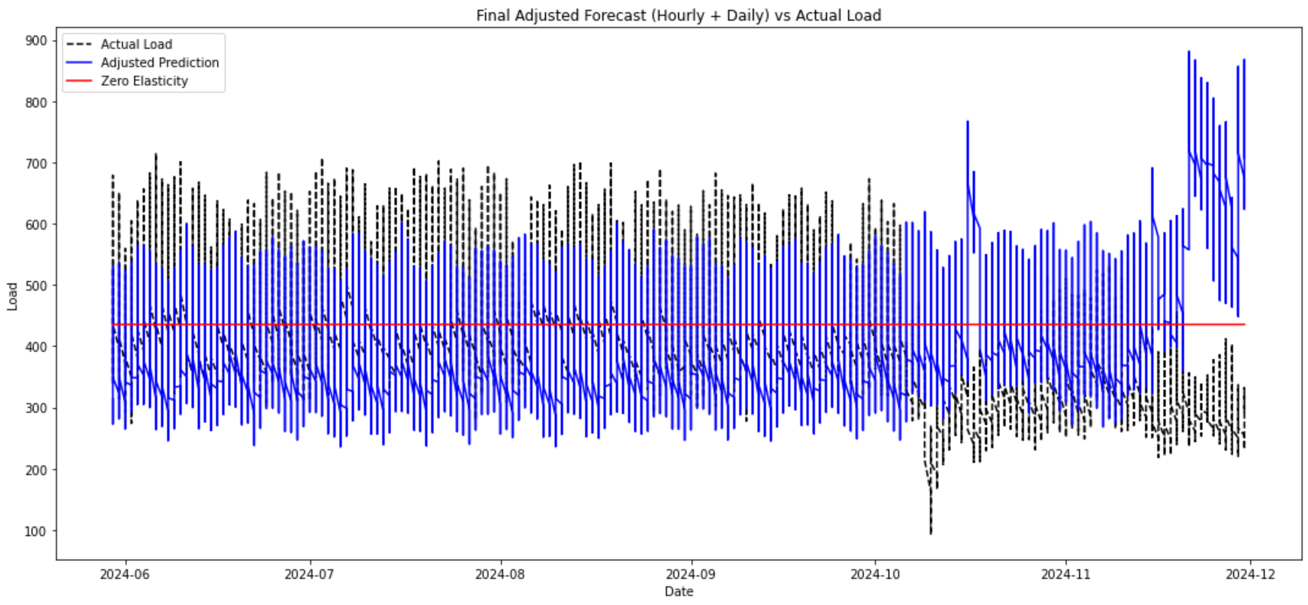
Sensitivity Analysis
Black = Actual Load
Blue = Baseline Prediction
  Average Elasticities from Research
Red = Zero Elasticity
  Constant load unaffected by externals
Applied hourly and daily bias corrections to improve baseline alignment
Notes:
Nick

Slide 10
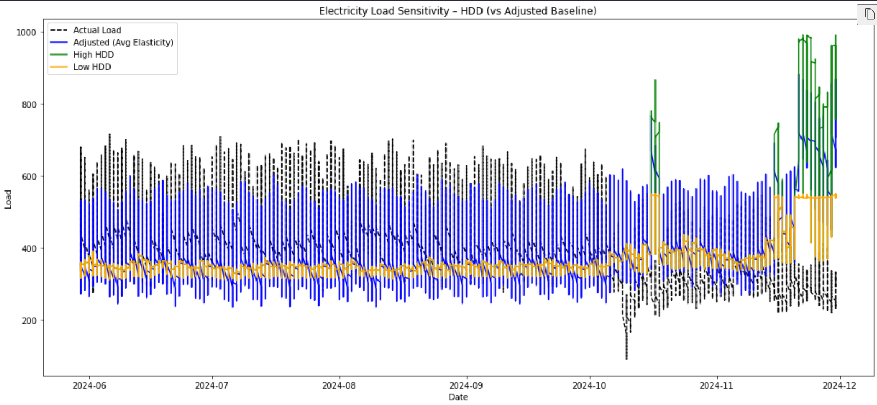
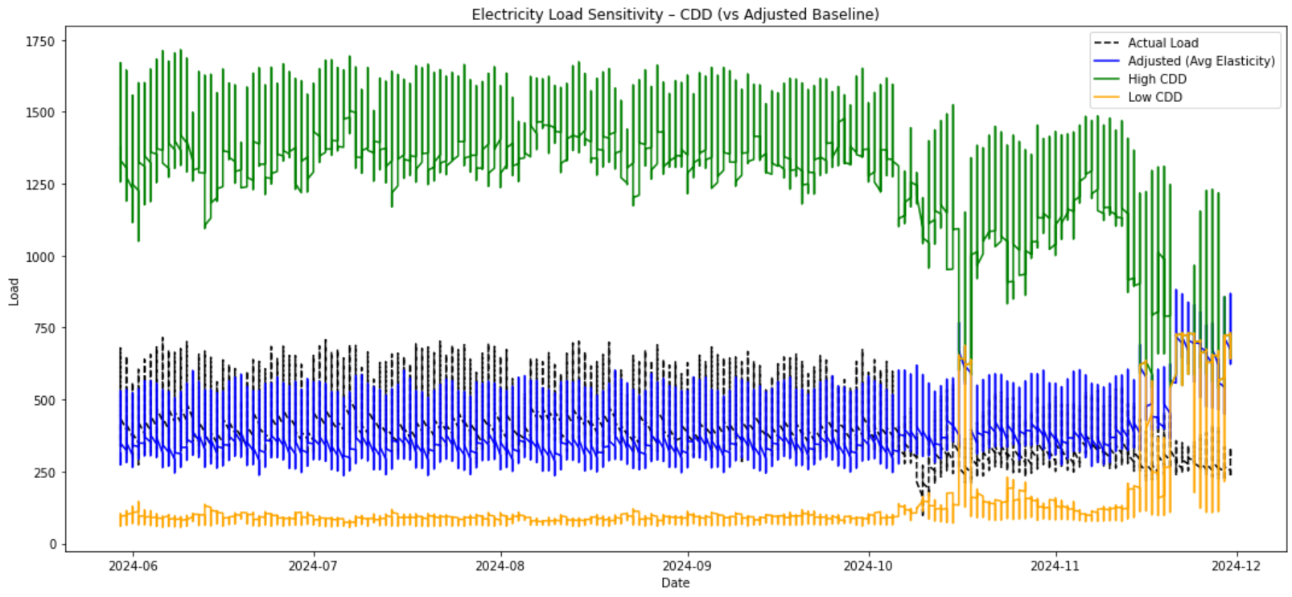
Sensitivity Analysis – HDD and CDD
HDD/CDD - Heating/Cooling Degree Days
- Shows how far the temperature is from 65°F, signaling demand for heating or cooling.
Strong Sensitivity:
- CDD – high sensitivity in warm months; hotter temps lead to significantly higher load
- HDD – low sensitivity for most of the year, but highly sensitive when heating is needed
Average estimate (blue) underpredicts the effect of both on load demand, especially during seasonal extremes.
Notes:
Josiah

Slide 11
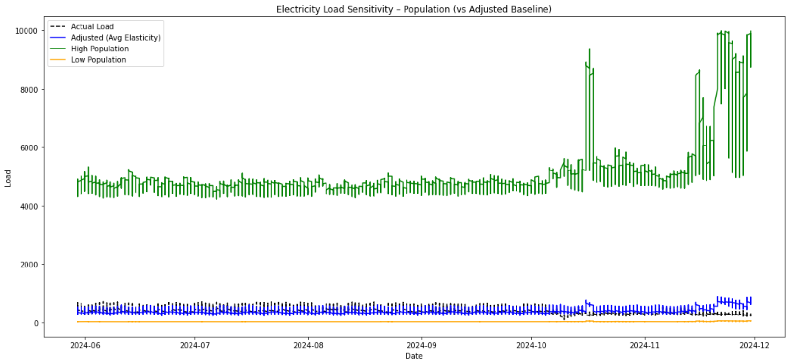
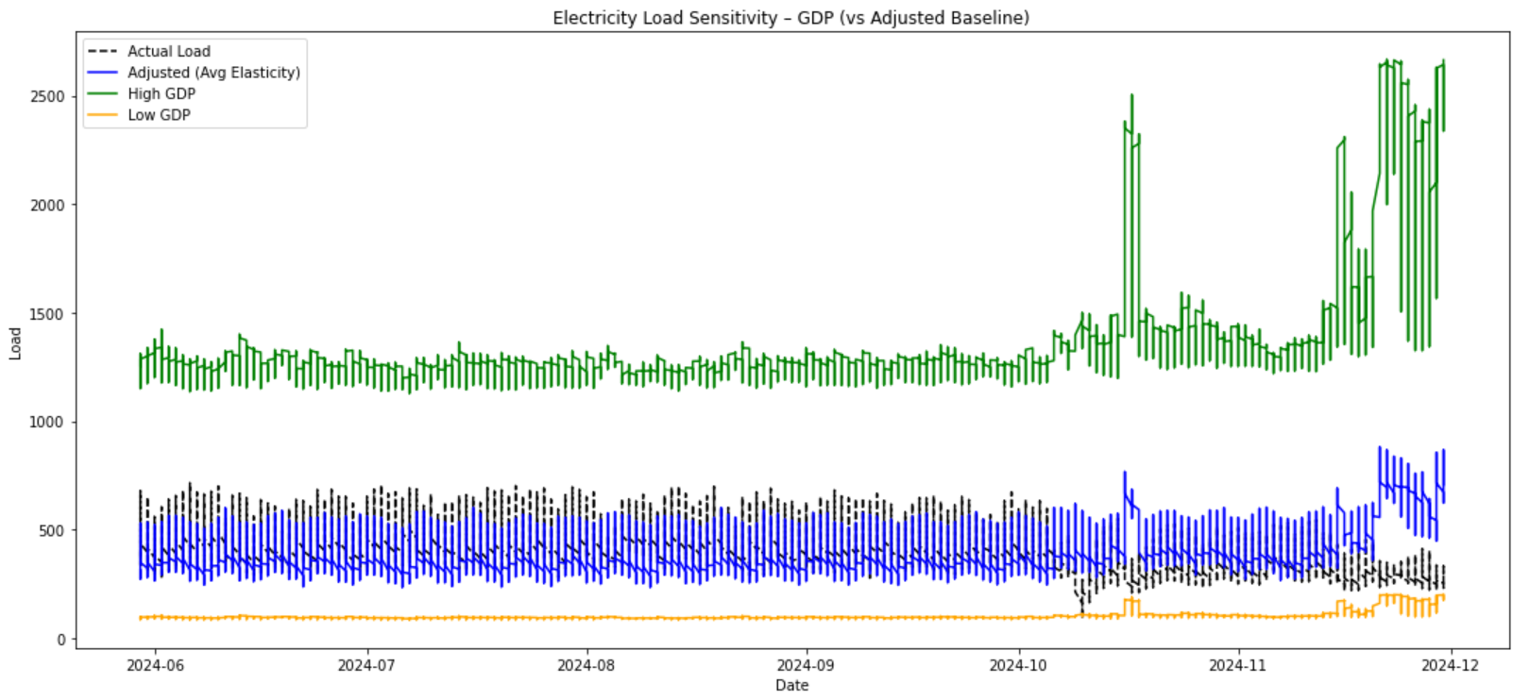
Sensitivity Analysis – Income (GDP) and Population
Strong Sensitivity:
- Population – larger population results in substantially larger loads
- Income (GDP) - increased income results in larger load usage
Average estimate (blue) underpredicts the effect of both on load demand
Notes:
Josiah

Slide 12
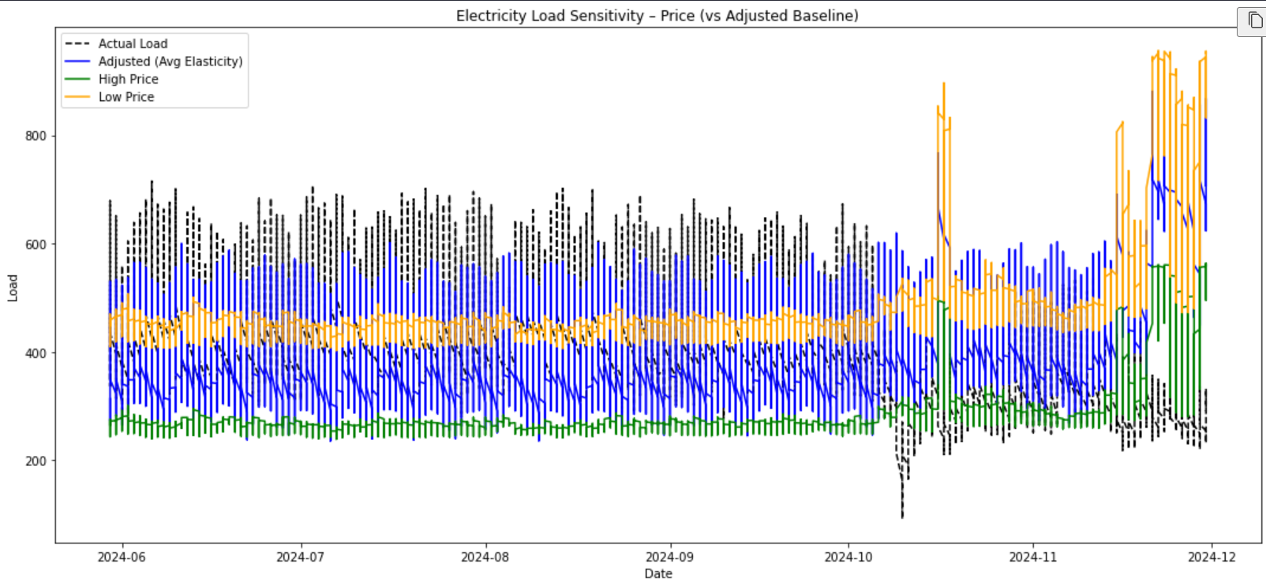
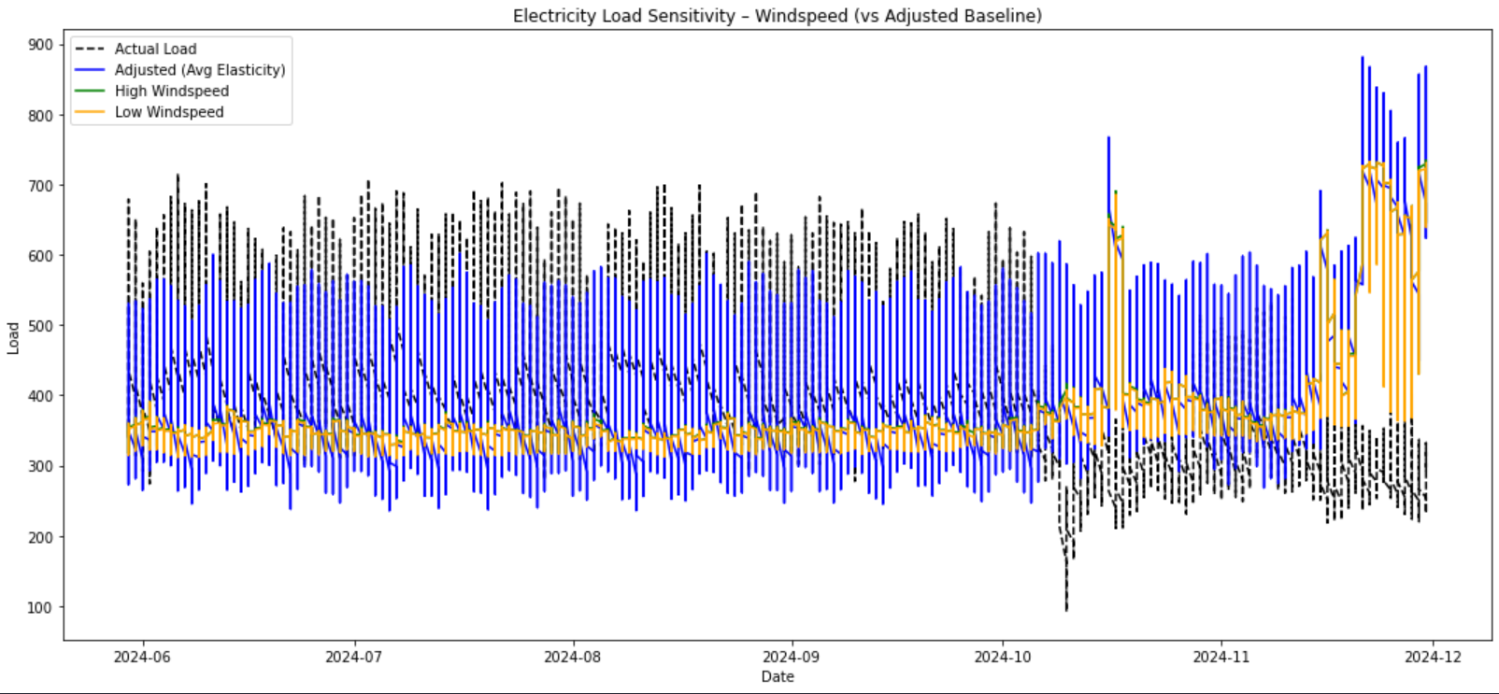
Sensitivity Analysis – Price and Windspeed

Slide 13
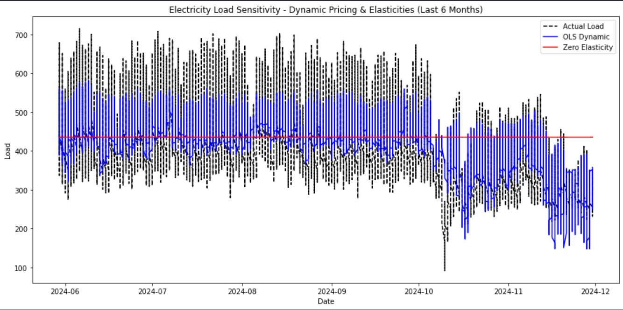
Sensitivity Analysis – Lakeland Specific Elasticities
Static Price, Income, and HDD/CDD fall within research elasticity ranges
Population and Wind Speed elasticities are just below the expected minimums
Research Range severely underestimates price elasticity for dynamic pricing
Every feature statistically significant except for price in the static model
Variable | Elasticity Range | Dynamic Pricing | Static Pricing
Price | -0.188 to -0.005 | -0.854 | -0.0186
Income (GDP) | 0.393 to 1.132 | 0.422 | 0.4342
Population | 0.109 to 0.883 | 0.0515 | 0.0415
HDD | 0.00 to 0.221 | 0.1801 | 0.1733
CDD | -0.66 to 0.335 | 0.2408 | 0.2351
Wind Speed | 0.011 to 0.022 | 0.0707 | 0.0635
Notes:
Josiah

Slide 14
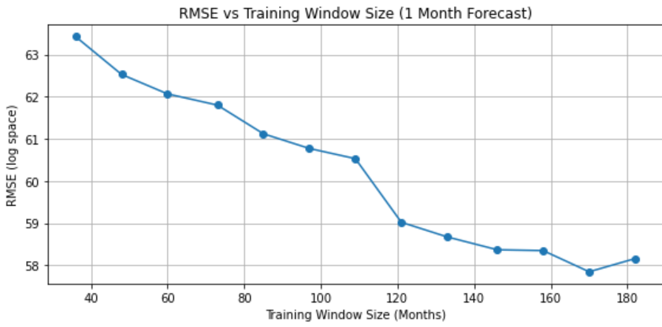
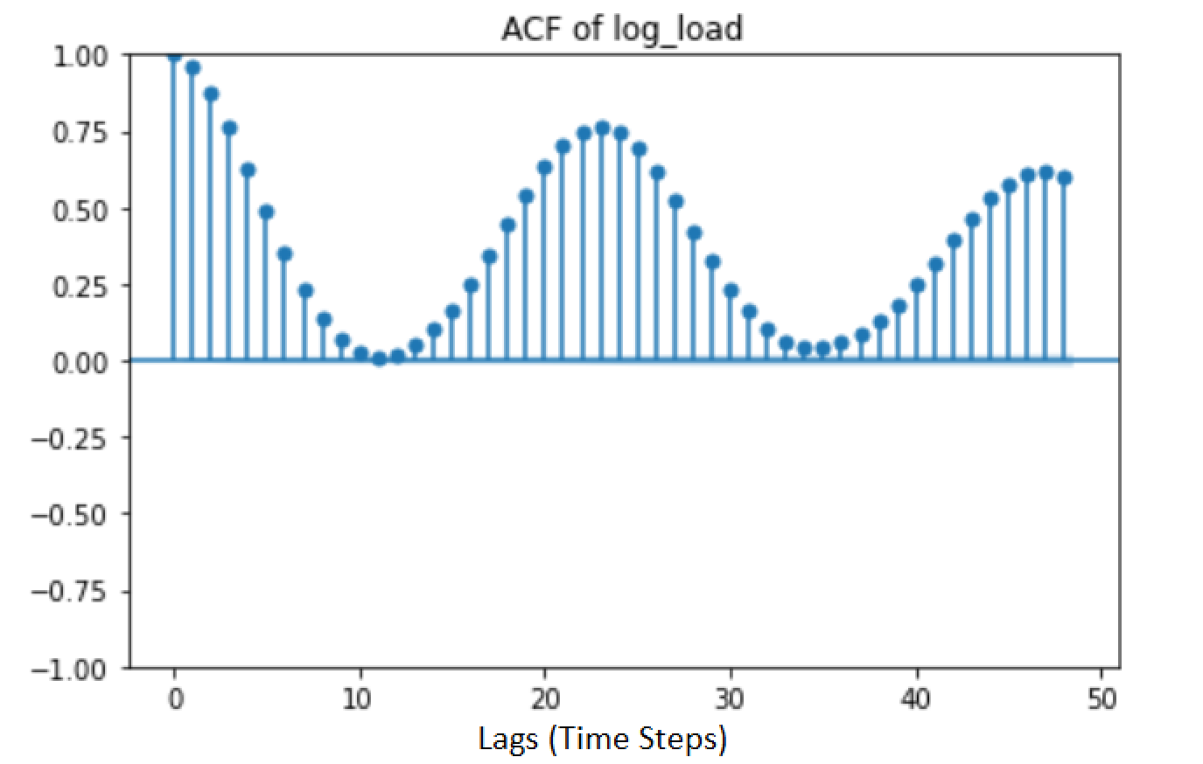
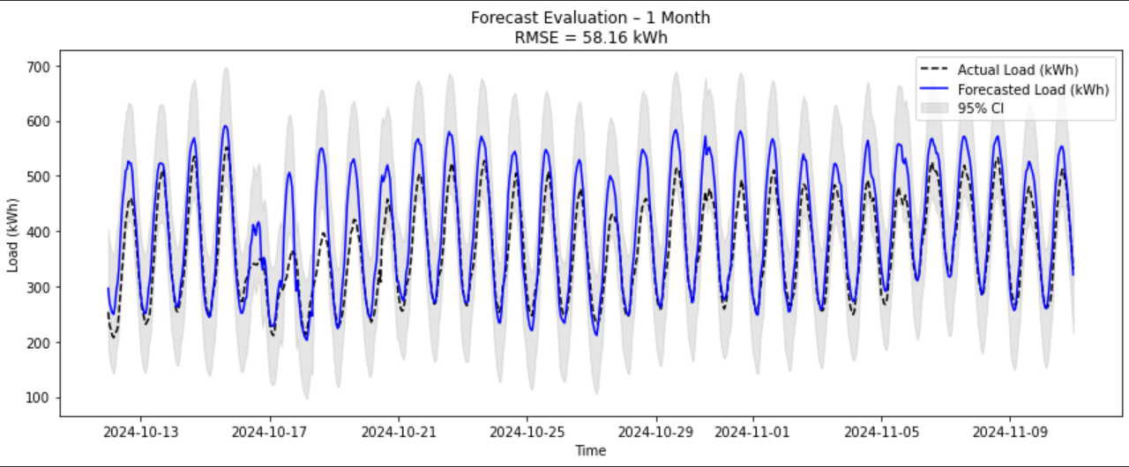
Rolling Windows Analysis - Comparison On Models
Rolling Windows (Hourly Data):
  1-month, 1-year, and 10-year optimal windows determined
  24 Hour seasonality
Models Tested:
  OLS (Research Based vs Lakeland Fit)
  SARIMAX
  Holt-Winters
  Random-Forest
Notes:
Longer windows for the smaller forecasts to fully capture seasonality
Slightly shorter for 10 year forecast due to data size – largest window possible for our data
OLS (Ordinary Least Squares)
Purpose: Linear regression for modeling relationships between variables.
Use case: Static modeling; assumes residuals are uncorrelated.
Limitation: Doesn’t handle autocorrelation or seasonality well.
SARIMAX (Seasonal AutoRegressive Integrated Moving Average with eXogenous regressors)
Purpose: Time series forecasting with trend, seasonality, and optional exogenous variables.
Use case: Great for temporal data with autocorrelation and seasonality.
Strength: Handles complex time series + external predictors.
Holt-Winters (Triple Exponential Smoothing)
Purpose: Forecasting time series with level, trend, and seasonality.
Use case: Simpler alternative to SARIMAX when no exogenous variables are needed.
Strength: Fast, intuitive smoothing-based method.

Slide 15
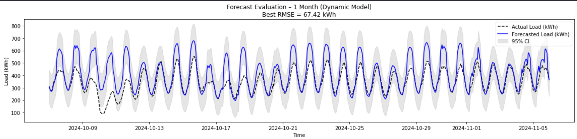
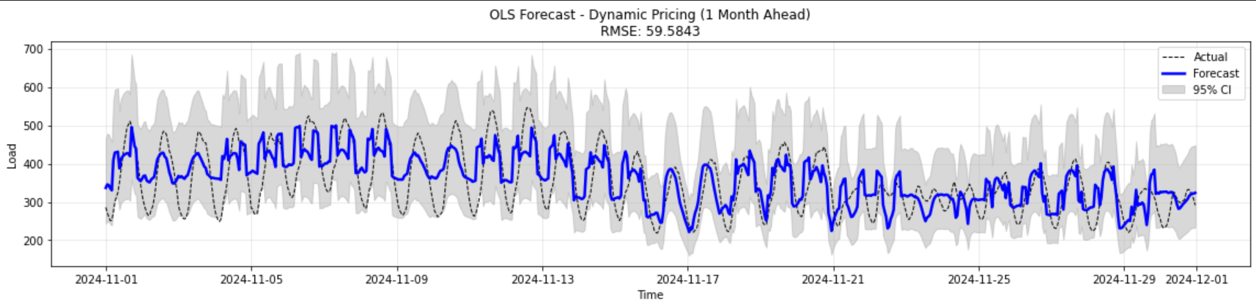
Forecasting Model Analysis - Comparison On Models Continued
Notes:
Josiah

Slide 16
Forecasting Model Summary
1 MONTH RMSE
Model Type | OLS (Fitted) | Research Model | Random-Forest | SARIMAX | Holt-Winters
Static Pricing | 58.69 | 58.16 | 61.15 | 50.21 | 55.78
Dynamic Pricing | 59.58 | 67.42 | 61.18 | 49.98 | —
1 YEAR RMSE
Model Type | OLS (Fitted) | Research Model | Random-Forest | SARIMAX | Holt-Winters
Static Pricing | 75.62 | 58.30 | 19.08* | Too slow to compute | 103.58
Dynamic Pricing | 66.75 | 67.64 | 18.99* | Too slow to compute | —
10 YEAR RMSE
Model Type | OLS (Fitted) | Research Model | Random-Forest | SARIMAX | Holt-Winters
Static Pricing | 70.10 | 58.52 | 29.07* | Too slow to compute | 383.10
Dynamic Pricing | 61.39 | 68.56 | 29.07* | Too slow to compute | —
* Overfitting or Data Leakage present – couldn't investigate further due to timeline constraints
Notes:
Josiah

Slide 17

Summary
Sensitivity Analysis: HDD/CDD and Income/Population strongly impact load demand.
Elasticity Results: Lakeland-specific elasticities are crucial for understanding customer behavior and how to properly forecast load usage.
Price Sensitivity: No impact on load demand with static pricing, but extremely high impact with dynamic pricing
Model Recommendation:
  OLS model fit to Lakeland data when dynamic pricing is used
  Research Model is static pricing present
  Both are more interpretable and effective than SARIMAX without substantial computational power.
  Random-Forest clear overfitting/data-leakage, would need to investigate this further before judging its performance properly
Notes:
Maria

Slide 18

Future Work
Build on the optimal models we identified to forecast into the future.
Replace HDD/CDD with hourly temperature curves to better reflect load sensitivity
Expand the model beyond the current residential subset to include the entire customer base
Notes:
Maria

Slide 19
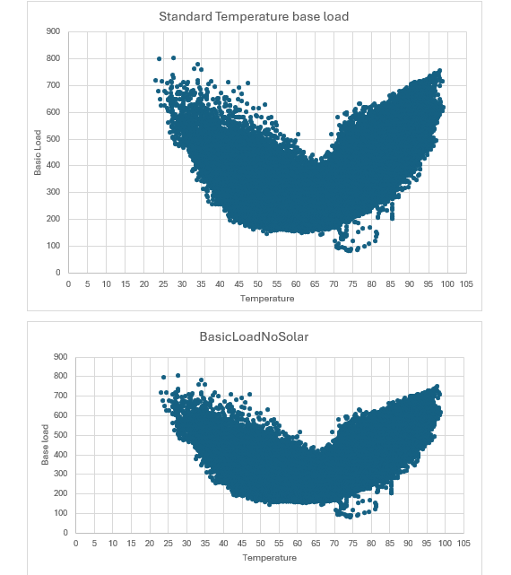
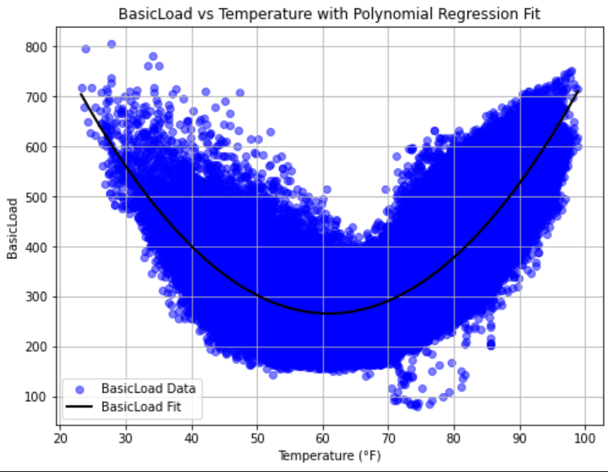
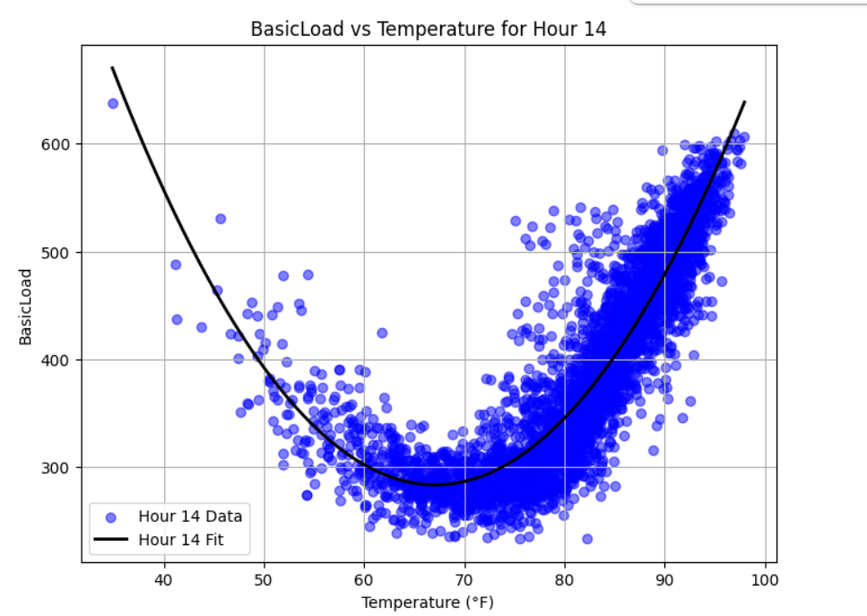
Temperature Analysis
Hour | Polynomial | Minimum Temp (°F)
1 | 0.3682x² - 43.96x + 1540 | 59.92
2 | 0.3620x² - 43.63x + 1521 | 60.16
3 | 0.3582x² - 43.52x + 1507 | 60.38
4 | 0.3553x² - 42.86x + 1497 | 60.61
5 | 0.3535x² - 43.04x + 1512 | 60.88
6 | 0.3574x² - 43.67x + 1561 | 61.48
7 | 0.3552x² - 43.68x + 1648 | 62.74
8 | 0.3275x² - 42.86x + 1673 | 65.44
9 | 0.2987x² - 40.72x + 1683 | 67.33
10 | 0.3113x² - 42.29x + 1738 | 67.84
11 | 0.3631x² - 45.70x + 1846 | 67.31
12 | 0.3612x² - 48.79x + 1950 | 66.04
13 | 0.3722x² - 49.56x + 1999 | 66.97
14 | 0.3632x² - 47.79x + 1883 | 66.06
15 | 0.3431x² - 44.43x + 1732 | 61.67
16 | 0.3141x² - 39.51x + 1539 | 62.89
17 | 0.2892x² - 35.32x + 1380 | 61.07
18 | 0.2753x² - 33.14x + 1313 | 60.21
19 | 0.2834x² - 34.54x + 1391 | 60.91
20 | 0.3021x² - 36.74x + 1453 | 60.82
21 | 0.3382x² - 42.12x + 1574 | 60.33
22 | 0.3382x² - 45.96x + 1678 | 59.83
23 | 0.3180x² - 45.38x + 1633 | 59.81
24 | 0.3715x² - 44.39x + 1571 | 59.74
Notes:
Josiah

Slide 20

Questions?

Slide 21
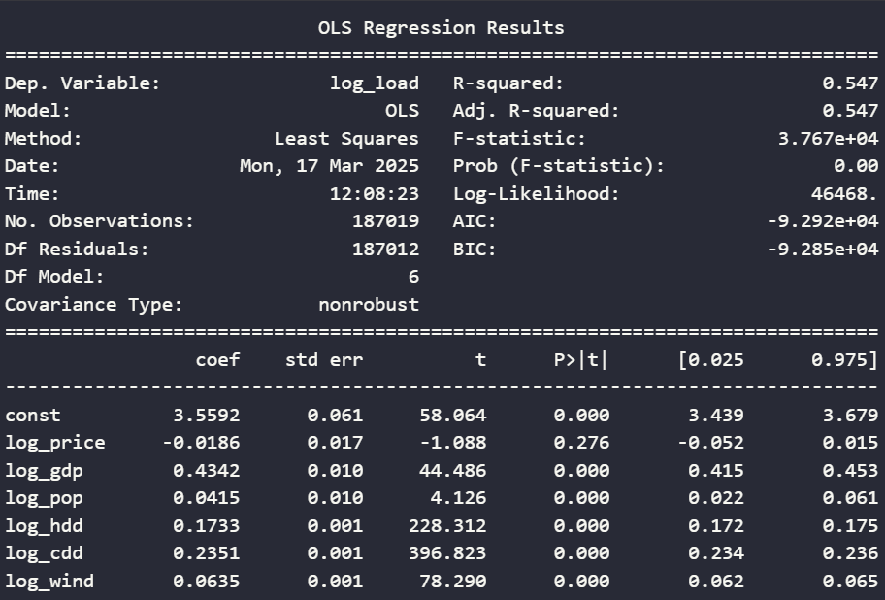
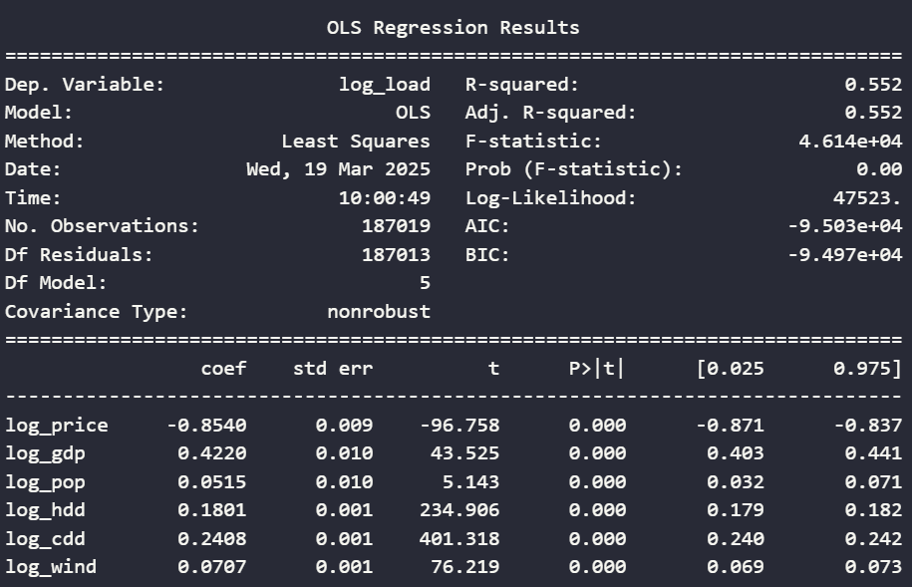
Sensitivity Analysis – Lakeland Specific Elasticities
Notes:
Josiah

Slide 22
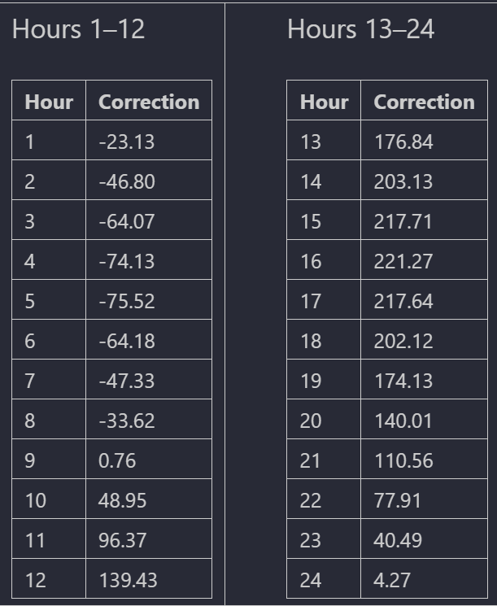
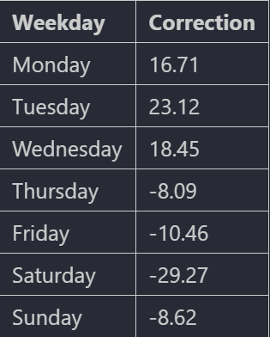
Research Model – Baseline Adjustments (kWh)
Adjustments:
- (+) means base model underrepresents at that time/day, (-) means overrepresents
Notes:
Josiah

Slide 23
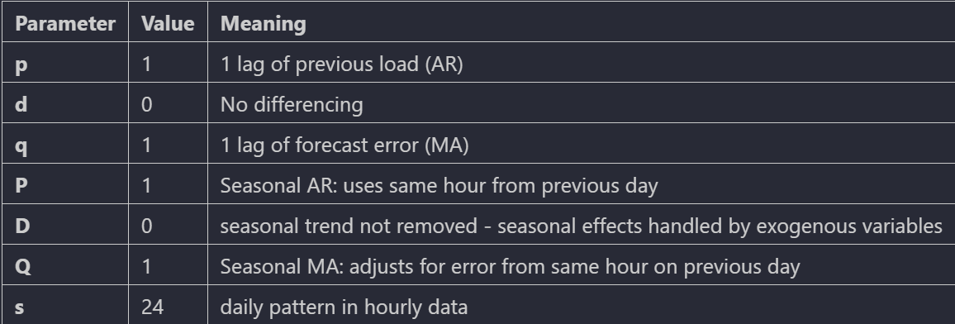
SARIMAX
sarima_order = (p, d, q)
seasonal_order = (P, D, Q, s)
SARIMAX:
- Seasonal AutoRegressive Integrated Moving Average with eXogenous regressors
Notes:
Josiah

Slide 24
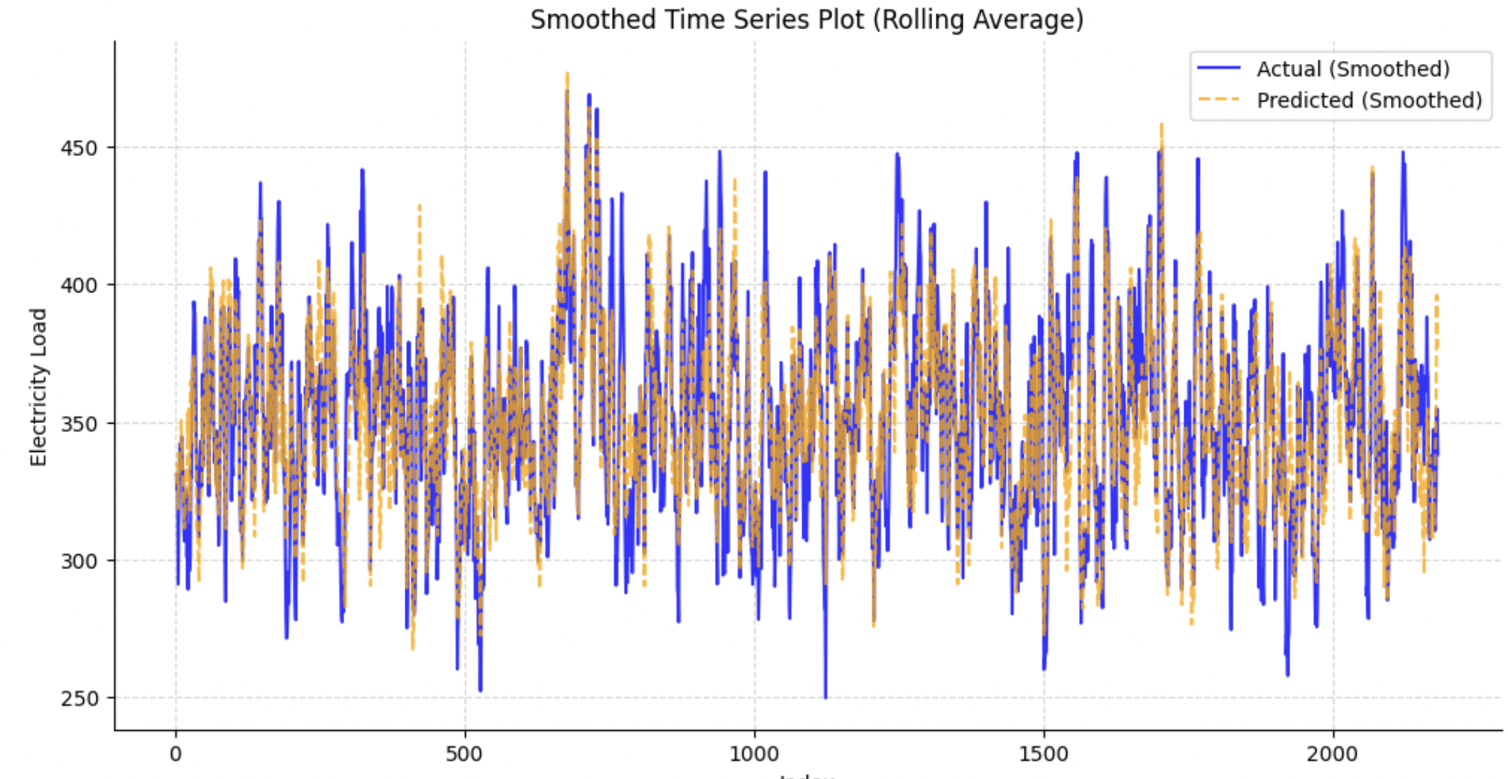
Old Random Forest Model
Creates multiple decision trees using random subsets of data (bootstrapping)
Our model is an average of all trees
Parameter:
  N_estimators: 100
  max depth:20
  min_samples_split:5
Split:
  Train: 80%
  Test: 20 %
Notes:
Jovan/Mariah

Slide 25
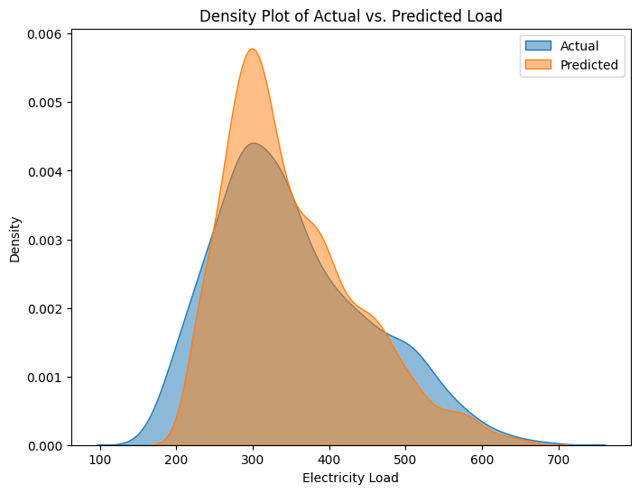
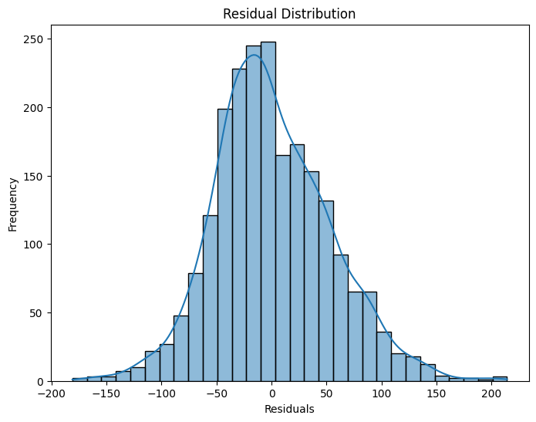
Old Random Forest Model Continued
Fairly normally distributed
Centered around zero​
Tends to slightly under predict
Slight Bias
Notes:
Jovan/Mariah

